Slide 1
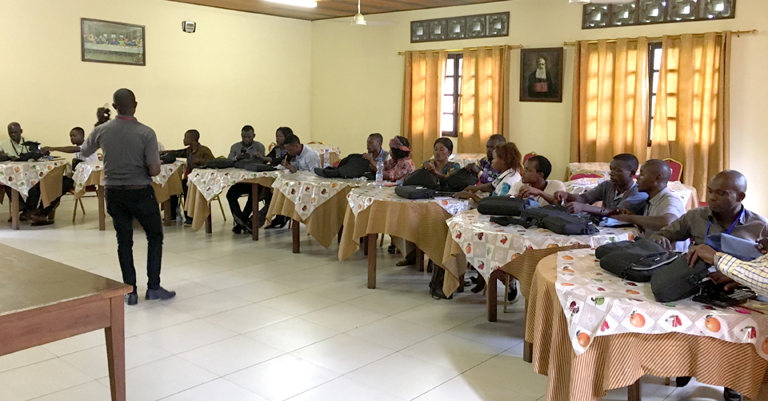
Workshop Planning

Slide 2

Inspirational Devotions
Revelation 5
Matthew 28:19
Genesis 6
God created languages
All languages will worship Him
Teaching to observe all things
Include translated verses each day

Slide 3

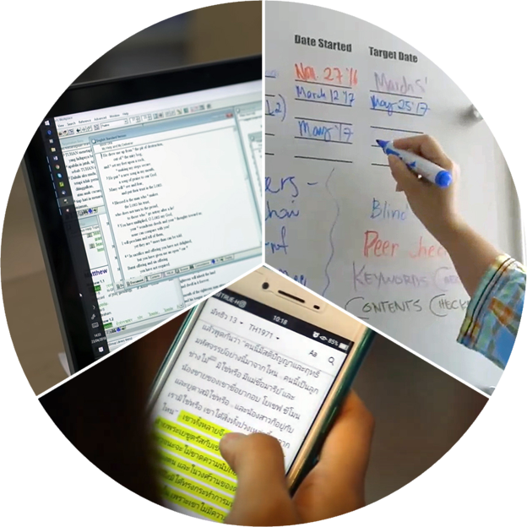
Meeting the Needs of Translators
Physical and spiritual / interpersonal needs
Workshop necessities
Consider the challenges of working from home

Slide 4

Zone of Proximal Development
Team Skills Inventory
3-circle drawing for ZPD
A learner increases his skill by working with someone 1 step ahead.
An outer ring of skill is still beyond learner.
Example of ZPD—baby learning to walk; learning to ride a bike.
Learners do better with someone who will meet them in the middle circle..
Picture of scaffolding
Learners receive support like a scaffold in layers so they can reach higher.
Teams Skills Inventory helps leaders form teams of translators that can work well together.
Should be done at beginning of workshop.
Group translators with others of similar skill level.
Skills assessed: GL ability, HL ability, Bible knowledge, Tech Knowledge, thinking style.
What kinds of needs might keep translators from focusing on work?
How do leaders at a MAST event help provide for these needs so translators can learn and work?
Learner can do with guidance
Learner can do unaided
Learner cannot do
Learners receive support like a scaffold

Slide 5
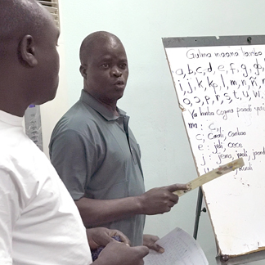
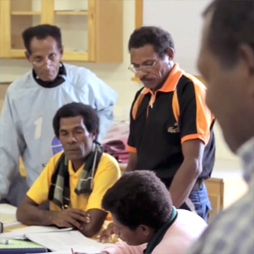
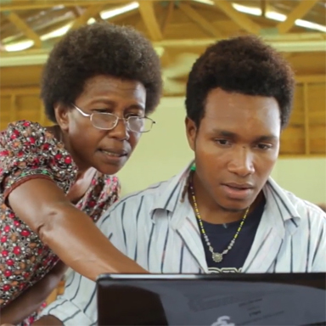
Team Skills Inventory
GL ability
HL ability
Bible knowledge
Tech Knowledge
Thinking style
Form teams that work well together
What needs prevent translator focus?
How will MAST leaders provide for these needs?

Slide 6


